Slide 1
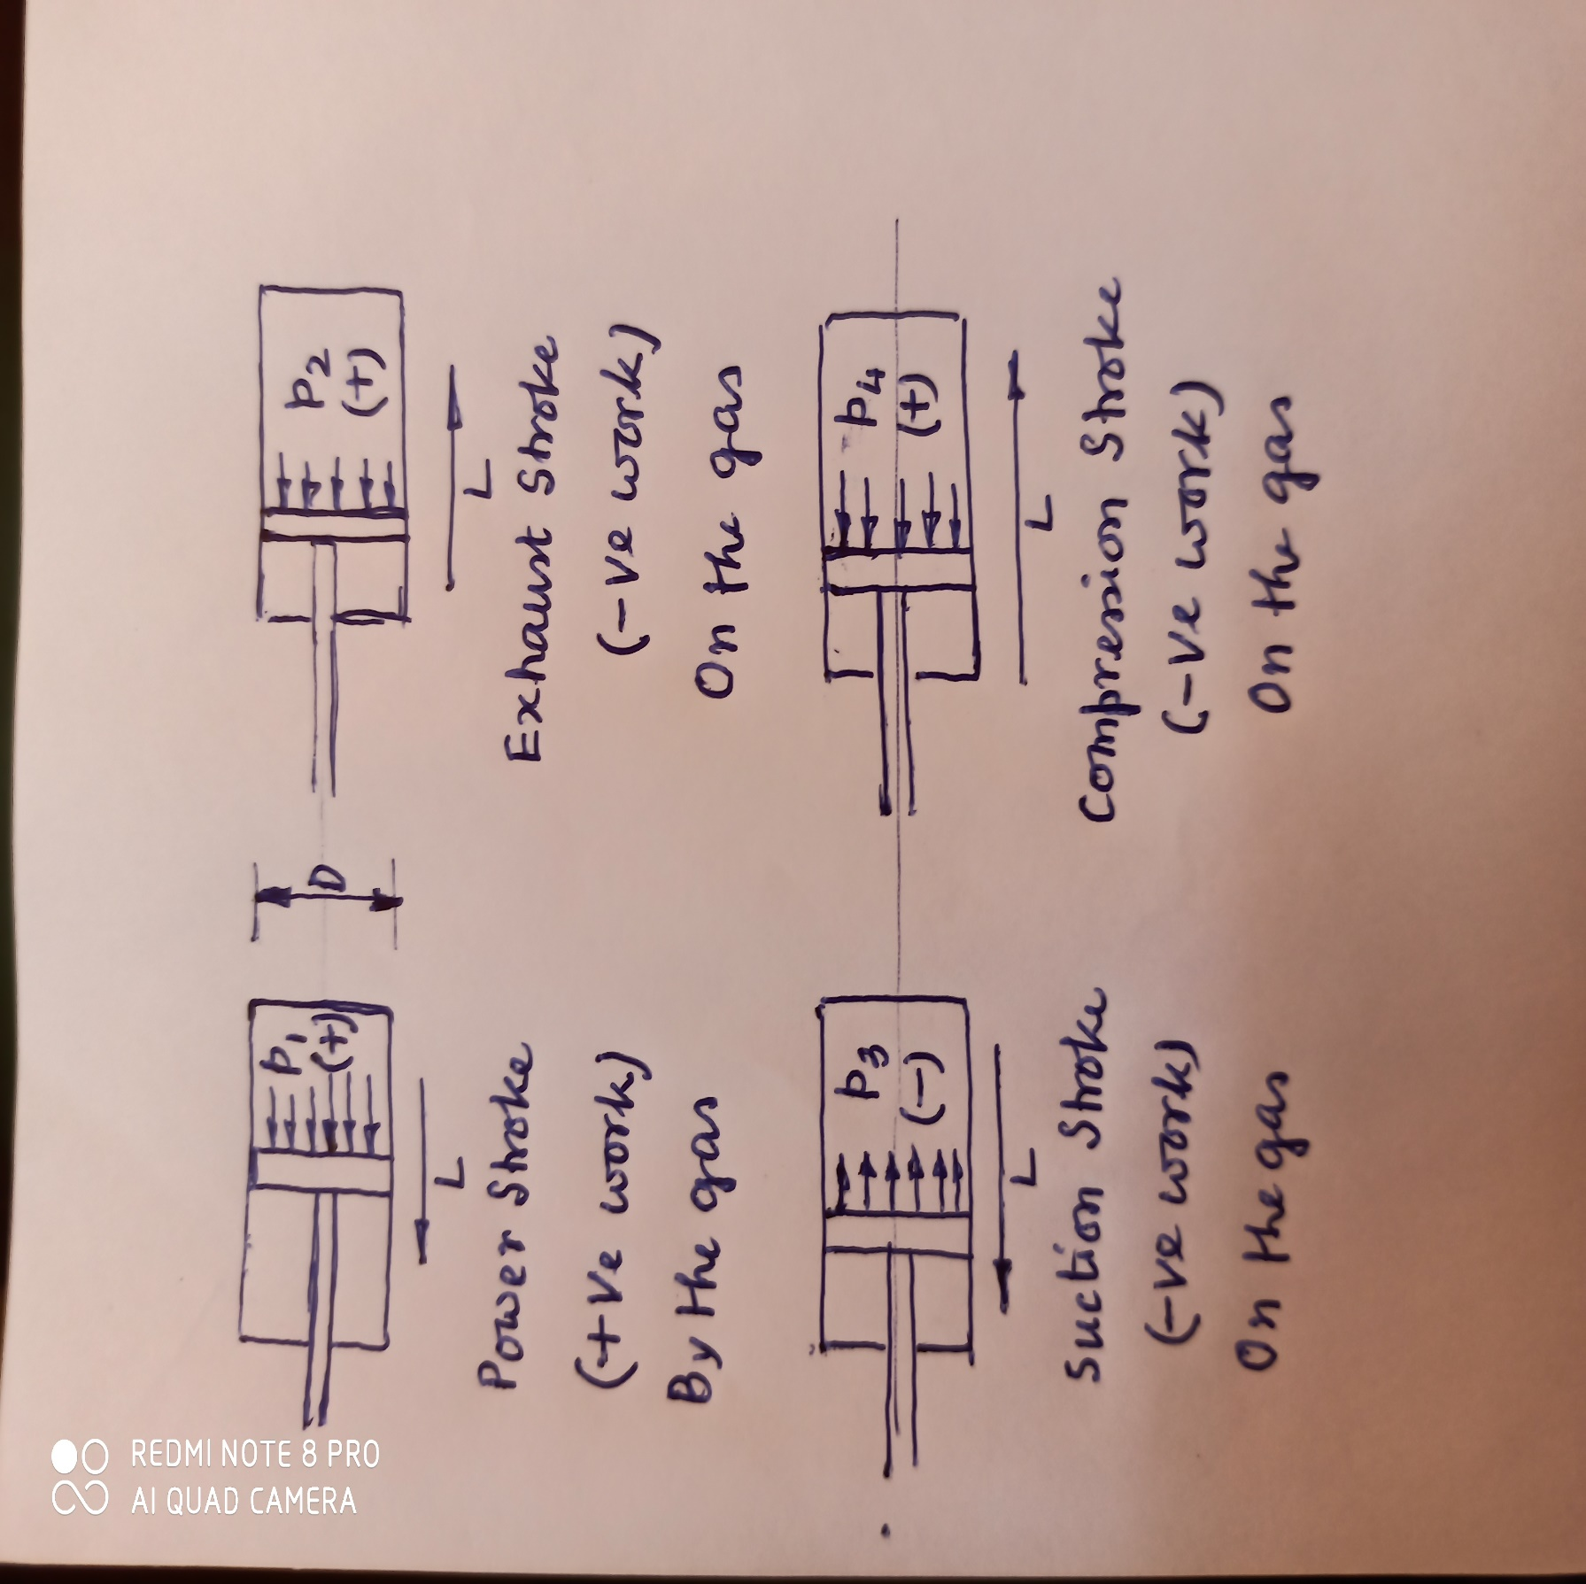
Estimation of Fluctuation of Energy from Indicator Diagram (Type 2)
For a four stroke petrol engine, let the mean pressures (gauge) during firing, exhaust, suction and compression strokes are p₁, p₂, p₃ and p₄ respectively. Obviously p₁, p₂ and p₄ are positive gauge pressures whereas p₃ is negative.
Now, Work done during the cycle = Work done during firing stroke (by the gas) + Work done during exhaust stroke (on the gas) + Work done during suction stroke (on the gas) + Work done during compression stroke (on the gas) = (πD²/4){(p₁)(L) + (p₂)(-L) + (-p₃)(L) + (p₄)(-L)} = AL(p₁-p₂- p₃-p₄) = 4p_{m}AL where the mean effective pressure (m.e.p.) for the cycle of the 4-stroke engine is p_{m} = (p₁-p₂- p₃-p₄)/4 Therefore, power developed by the engine = WD by the engine (gas)/second = WD/cycle x cycle/rev x rev/sec = (4p_{m}AL) x (1/2) x (N/60) = p_{m}LAN/30

Slide 2
(continued)
As excess power is developed during the firing stroke,
Therefore, fluctuation of energy E_{f} = LA(p₁– p_{m})
** While calculating p_{m}, it should be noted that only the numerical values (without their sign) of the mean pressures p₁, p₂, p₃ and p₄ are to be put in the expression as the gauge pressure values have already been taken into account while calculating work done (assumption: by the gas +ve) during each of the individual strokes.

Slide 3
Fluctuation of Energy: Problem Type 2
A gas engine working on Otto cycle is provided with two flywheels each having a mass of 600 kg and a radius of gyration of 50 cm. The diameter of the cylinder is 24 cm, stroke 27 cm and the mean speed is 250 rpm. The mean pressures during the cycle are: during suction stroke -0.5 kPa, during compression stroke +100 kPa, during power stroke +600 kPa and during exhaust stroke +30 kPa. If the resistance is constant find the percentage variation of speed of the engine.
A single cylinder four stroke petrol engine has bore and stroke of 75 mm and 100 mm respectively. Mean pressures during firing, exhaust, suction and compression strokes are 10, 0.3, -0.1 and 1.0 bar respectively when the engine is running at a mean speed of 3000 rpm and delivering at a constant rate. Under these conditions the speed fluctuates by 0.2%. What is the moment of inertia of the rotating parts? If a twin cylinder engine were to be made utilizing the same flywheel but providing twice the torque, what would be the speed fluctuation at a mean running speed of 500 rpm?

Slide 4
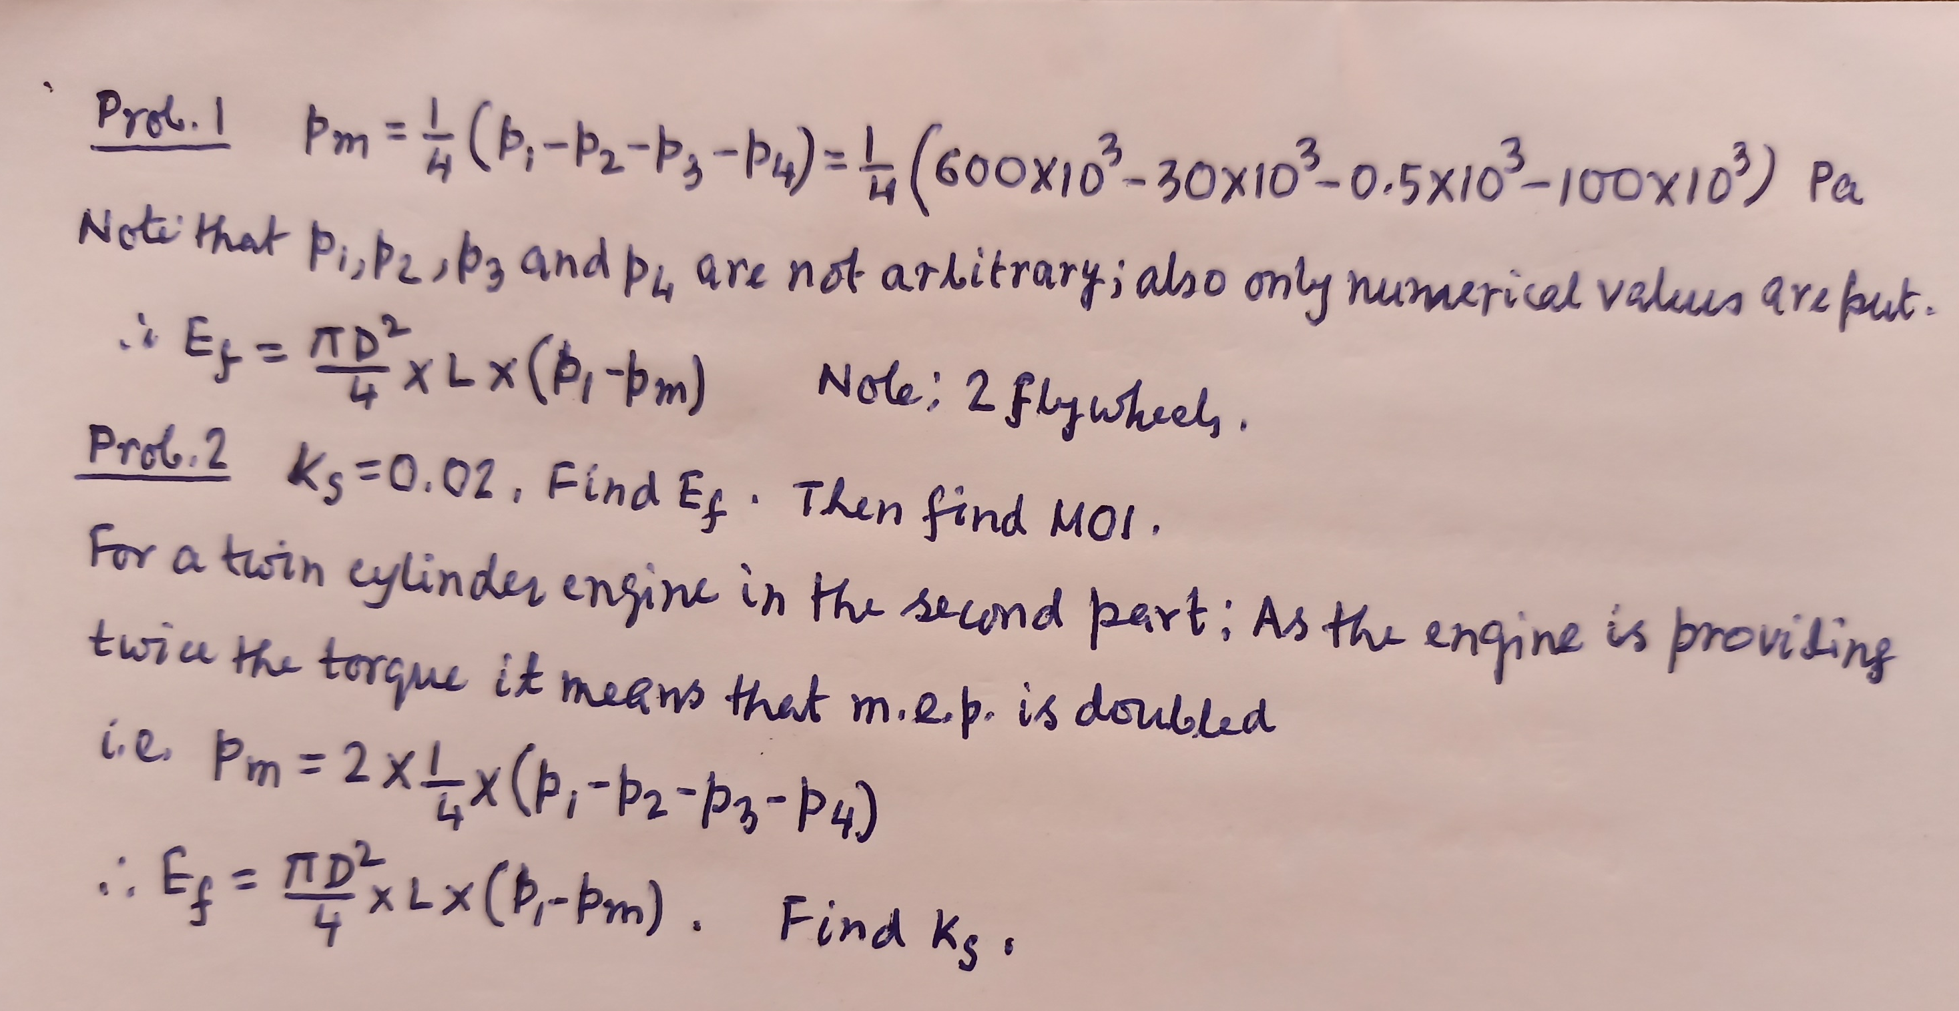
Hints for Problems: Type 2

